Slide 1
Sphero Spark 2 Triathlon

Slide 2
Team Member Roles
Arnab - Lead Developer:
Responsible for overseeing the algorithm development process, coordinating team members, and ensuring the project's progress aligned with the timeline. Also responsible for designing and implementing critical algorithm components and conducting thorough testing and debugging.
Jason - Developer/Tester:
Responsible for contributing to the algorithm development process by designing and implementing specific algorithm components, conducting testing, and providing feedback. Collaborated with the team and followed the guidance of the Lead Developer to ensure successful algorithm development.

Slide 3
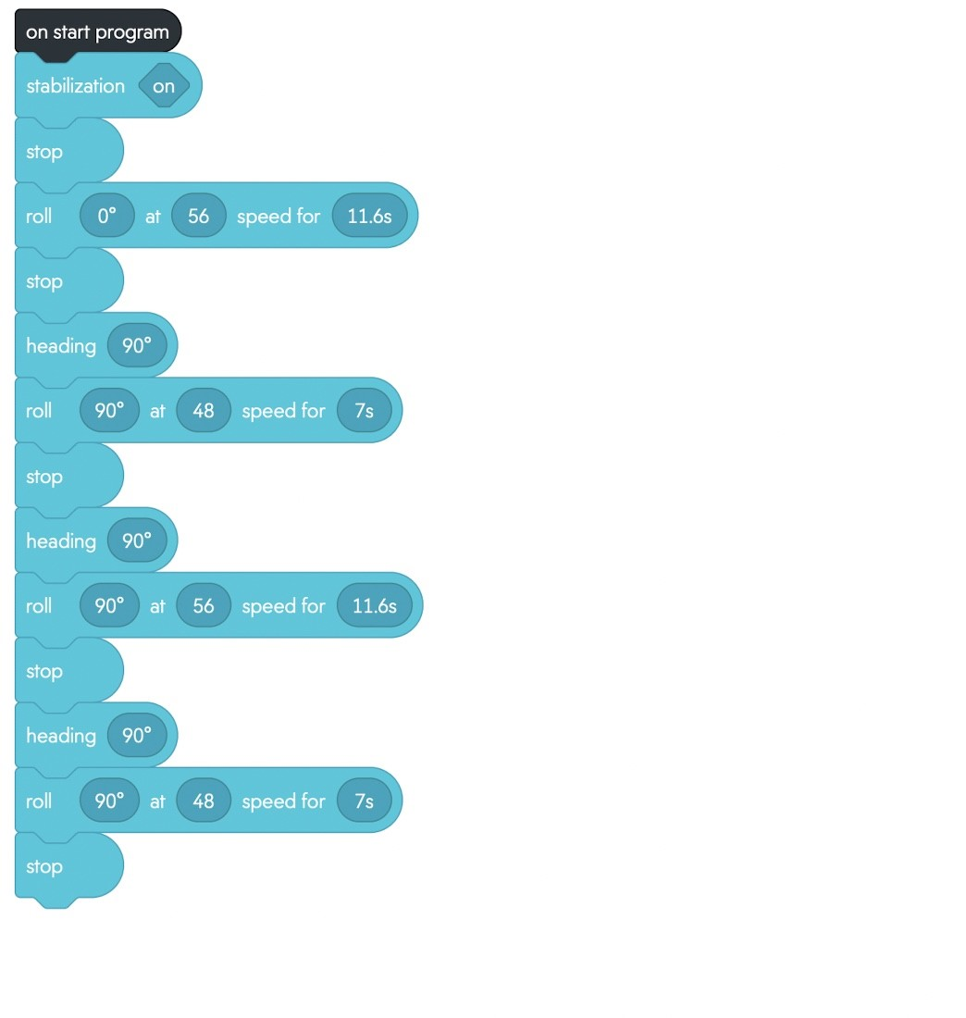
Sprint 1 - Endurance

Slide 4
Challenges Faced
Initial Placement: Ensuring the Sphero Spark 2 started from the correct position for each segment of the triathlon
Straight Line Navigation: Developing algorithms to make the Sphero Spark 2 move in a straight line was challenging. Ensuring consistent and accurate straight-line navigation was a significant hurdle in the algorithm development process.
Course Tracking: Ensuring the Sphero Spark 2 stayed on the designated course throughout the triathlon was challenging. Developing algorithms to accurately track the course and make real-time adjustments to keep the device on track required careful consideration and testing.

Slide 5
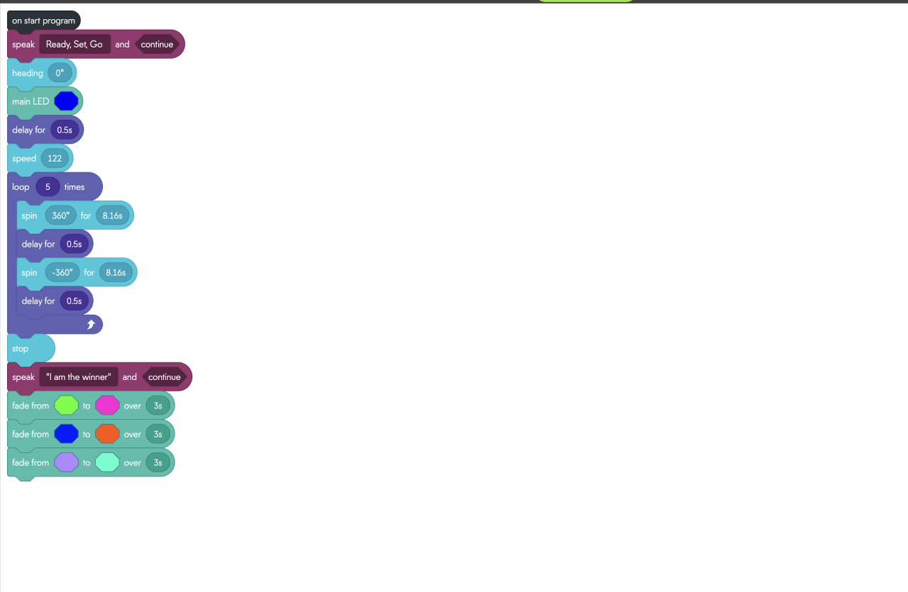
Sprint 2 - Accuracy

Slide 6
What We Learned About Software Engineering
Project Planning and Management: Through this project, we learned the importance of effective project planning and management, including setting clear goals, allocating resources, and tracking progress to ensure timely completion of the project.
Time Management: Managing time efficiently to meet project deadlines was crucial in this project. We learned to prioritize tasks, set deadlines, and allocate time effectively to ensure the project's smooth progress.
Coding Concepts and Implementation: Developing algorithms for the Sphero Spark 2 triathlon required a deep understanding of coding concepts and implementation, including sensor integration, decision-making, and navigation algorithms. We gained practical experience in implementing these concepts in a real-world project.

Slide 7
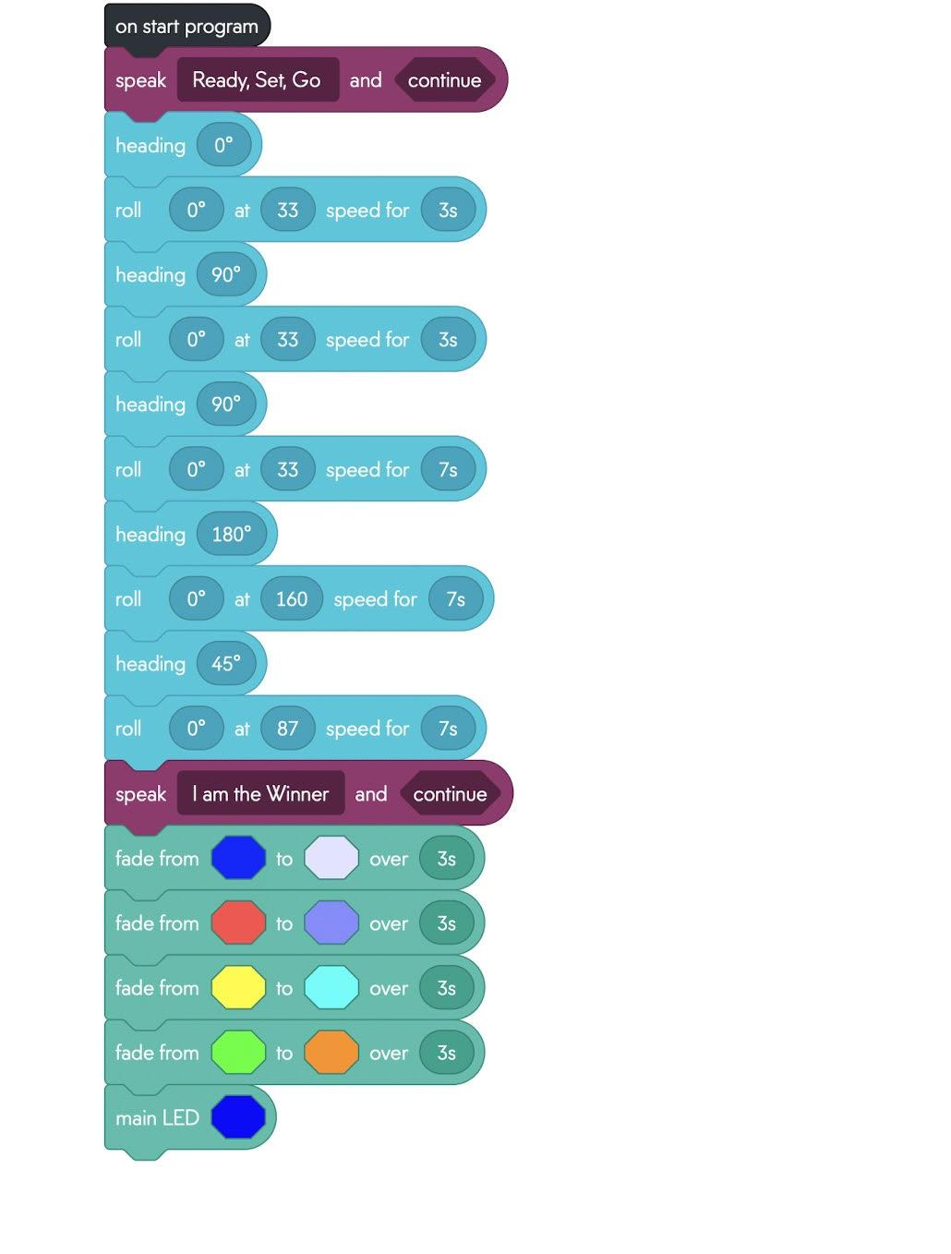
Sprint 3 - Agility

Slide 8
What We Would Do Differently
Improved Testing and Debugging: In hindsight, we would allocate more time and resources for extensive testing and debugging of the algorithms. This would help identify and fix any issues early in the development process and ensure higher algorithm accuracy and reliability.
Enhanced Collaboration and Communication: We realized the importance of effective collaboration and communication within the team for successful project completion. In future projects, we would emphasize more on regular team meetings, clear communication channels, and collaborative decision-making to improve overall project efficiency.
Enhanced Initial Placement and Calibration: Based on the challenges faced in ensuring accurate initial placement and calibration of the Sphero Spark 2, we would invest more time in developing robust algorithms for initial placement and calibration, considering various environmental factors that may affect the device's performance.

